Slide 1
Who is smart? /game application /
Team name : Magic

Slide 2
Content
Team introduction
Project introduction
Our program’s benefits
Use case diagram

Slide 3
Team introduction
Team name: Magic
Members: Usukhbaatar.D /IT3-2/
Unurtsetseg.E /IT3-2/
Dashkhand.B /IT3-2/

Slide 4
Project introduction
Project name: Who is smart?
Type: Game /desktop application/
Users: Children and major
Goal: People used this game for yourself free time and children mind grow.
How to play?
Next slide

Slide 5
How to play?
5+3+?=10
Open the application
Choose level
Start game
You have 3 stars
You guess a number
If your answer correct you got a star
If your answer false you miss a star
Your stars is 5, you won

Slide 6
Our program’s benefits
General
Understandable
Interesting
Have a funny leisure
Children’s mind grow
People disengage a stress

Slide 7
What design?
Commonly for children, design is interesting, arresting.
Using C# or Java

Slide 8
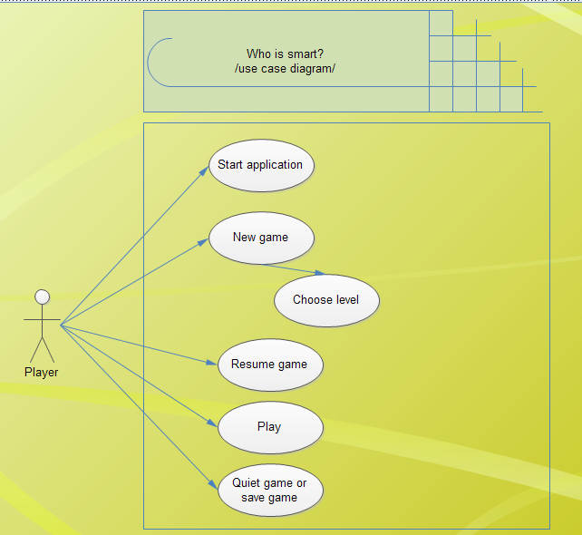
Use case diagram

Slide 9
Thank you!

